Slide 1
Flash card app

Slide 2
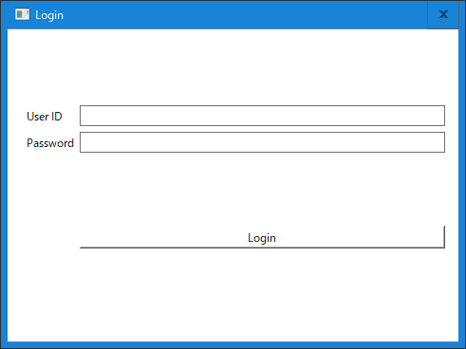
Login
To use the app, user id and password are entered and click Login button.
If possible, it would be helpful to add the following functions;
Auto login function which allows to store user id and password and automatically login when the app starts.
User creation function which allows to create a new user. (user id and password)

Slide 3
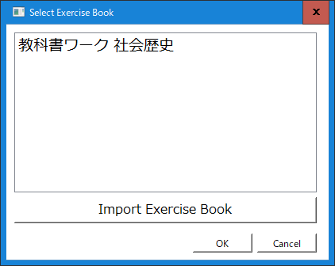
2. Select Exercise Book
Exercise books which have been imported are shown. The user selects one of the book and click OK button.
Question cards from the exercise book selected will be shown on the main screen.
To import an exercise book, click [import Exercise Book] button, and select a zipped file which includes JSON and images files(explained the following slide) and upload it to the server.

Slide 4
About Exercise Book JSON file
Json files and directories:
./questions_book.json
./answers_book.json
./questions/(image files)
./answers/(image files)
Sample of questions_book.json
{
"uuid": "45555b4a-ee9c-4860-9159-c3b604cf9739",
"file_name": "history",
"image_folder": "./image_file/history/questions",
"page": [
{
"pageNumber": 82,
"width": 1046,
"height": 1517,
"area": [
{
"uuid": "2a8e9b7b-a0e6-4c3d-bd8e-27786675308a",
"linked-uuid": "",
"areaNumber": "1",
"x": 77.5,
"y": 151.25,
"width": 378.75,
"height": 162.5,
"subAreas": [
{
"subUuid": "c6182147-6f1b-4c24-9709-fb28b98846ca",
"subNum": 0,
"x": 457.5,
"y": 155.0,
"width": 518.75,
"height": 328.75
}
]
},
These files and directories are zipped and uploaded to the server by the user. The server unzips it and imports the questions_book.json and answers_book.json file.
The jsons indicate image folder and each area and sub area information of the question and the related answer. (Sub areas are additional areas to the area optionally.)
Curently, Json files will be imported to MySQL DB which running at; Server: gotit.smagai.com:3306 User/Pass: usersql / 20220622

Slide 5
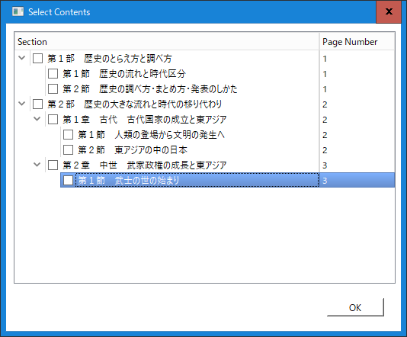
Select Contents
Contents information is shown according to the information in questions_book.json.
The user checks sections which he/she wants to answer questions from.
If he/she does not check, question cards from all sections are shown.
Sample questions_book.json
Question cards are retrieved from the sections checked which image file starts from startPage to endPage.
actualPageNum: The number is shown on the screen.
"contents": [
{
"section": "第１部 歴史のとらえ方と調べ方",
"startPage": 0,
"endPage": 1,
"actualPageNum": 1,
"parts": [
{
"section": "第１節 歴史の流れと時代区分",
"startPage": 0,
"endPage": 1,
"actualPageNum": 1
},
{
"section": "第２節 歴史の調べ方・まとめ方・発表のしかた",
"startPage": 1,
"endPage": 1,
"actualPageNum": 1
}
]
},
{

Slide 6
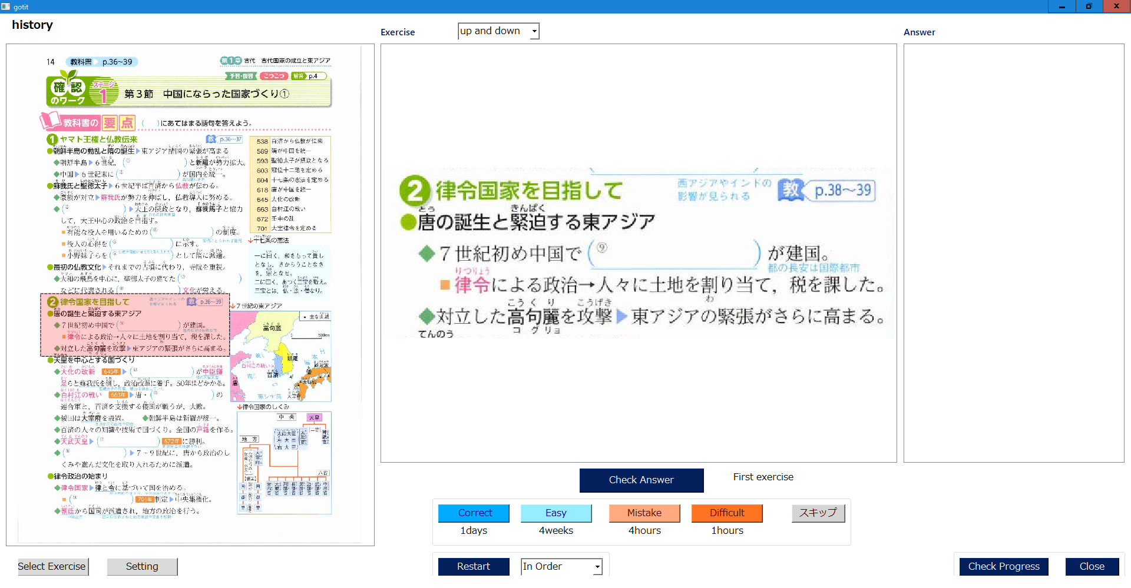
Main screen for PC
If questions and/or answers has main and sub areas (multiple areas), this drop-down changes the layout.
It shows the question which is cut out from the entire page image according to the JSON area information.
Exercise book title selected.
It shows the answer of the question when the user click [check Answer button].
I want to show the answer while the question card is turned over as the opposite side.
Entire page image is shown and the question area is indicated in red rectangle.
After the user checks the answer, the user selects whether the answer is correct or not and the difficulty.
Correct: Correct answer and not difficult
Easy: Correct answer and easy
Mistake: Wrong answer and not difficult
Difficult: Wrong answer and difficult
After that, the question card will be shown after the waiting period according to the button selected(1day, 4weeks, etc).
If the user clicks “skip” button, the question card is skipped.
The selection screen of Exercise book is shown to change the book.
If the user select [Shuffle], question cards are shown randomly, if [in order] is selected, cards are shown in order by the page and area number in JSON
When Restart button is clicked, the order selection(Shuffle or In Order) is applied.

Slide 7
Main screen for iOS/Android
If questions and/or answers has main and sub areas (multiple areas), this drop-down changes the layout.
It shows the question which is cut out from the entire page image according to the JSON area information.
Exercise book title selected.
It shows the answer of the question when the user click [check Answer button].
I want to show the answer while the question card is turned over as the opposite side.
Entire page image is shown in separated page as a mobile phone screen is small and the question area is indicated in red rectangle.
After the user checks the answer, the user selects whether the answer is correct or not and the difficulty.
Correct: Correct answer and not difficult
Easy: Correct answer and easy
Mistake: Wrong answer and not difficult
Difficult: Wrong answer and difficult
After that, the question card will be shown after the waiting period according to the button selected(1day, 4weeks, etc).
If the user clicks “skip” button, the question card is skipped.
The selection screen of Exercise book is shown to change the book.
If the user select [Shuffle], question cards are shown randomly, if [in order] is selected, cards are shown in order by the page and area number in JSON
When Restart button is clicked, the order selection(Shuffle or In Order) is applied.

Slide 8
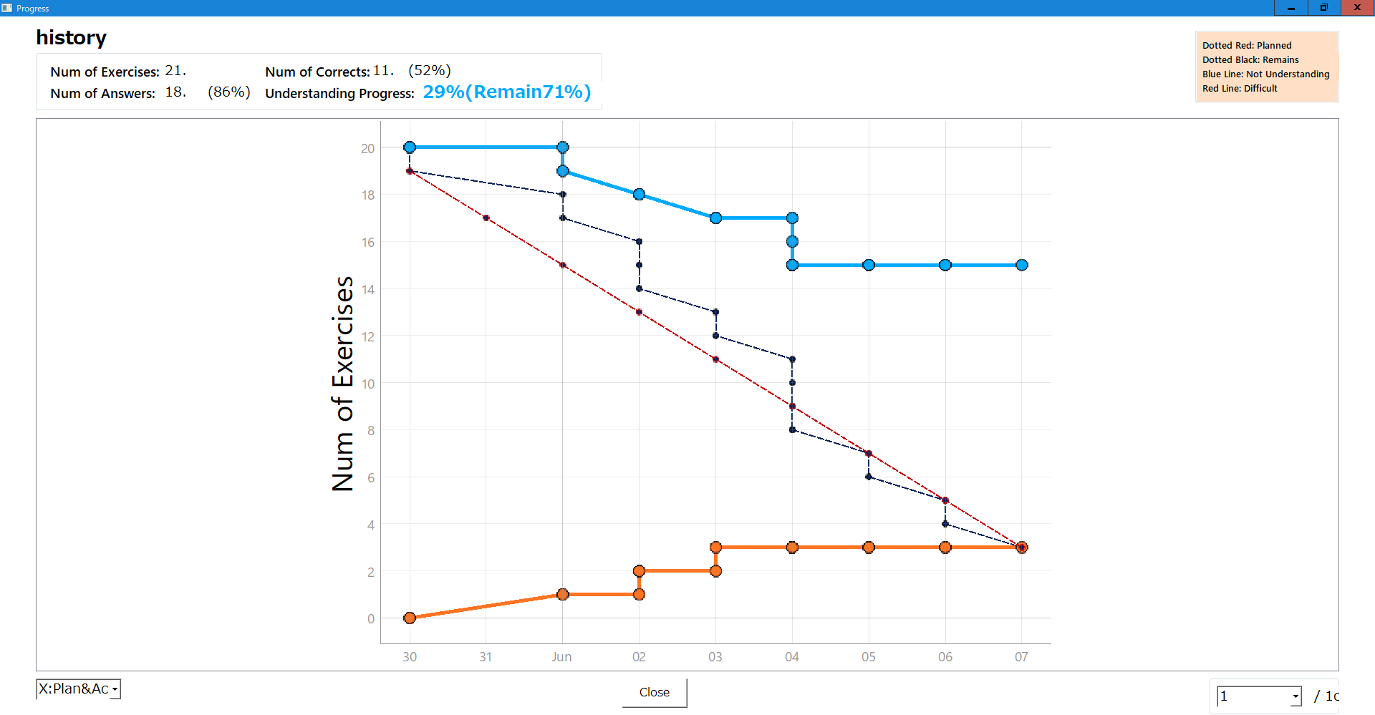
Progress
Num of exercises: total questions the exercise book has.
Num of answers: total questions the user has answered for the exercise book.
Num of Corrects: total questions the user has selected Correct or Easy for the exercise book
Understanding Progress: total number of questions minus total number of questions the user has selected Easy.
Red dotted line is planned schedule which is drawn according to the setting.
Black dotted line is actual number of answered.
Orange line is difficult question the user has selected.
Blue line is easy question number the user has selected.
The user can select X axis. [Time] and [Count].
When [Time] is selected, X axis is time base and when [Count] is selected, X axis is count base. Planning line is only shown for [Time]
Not used. no need to implement.

Slide 9
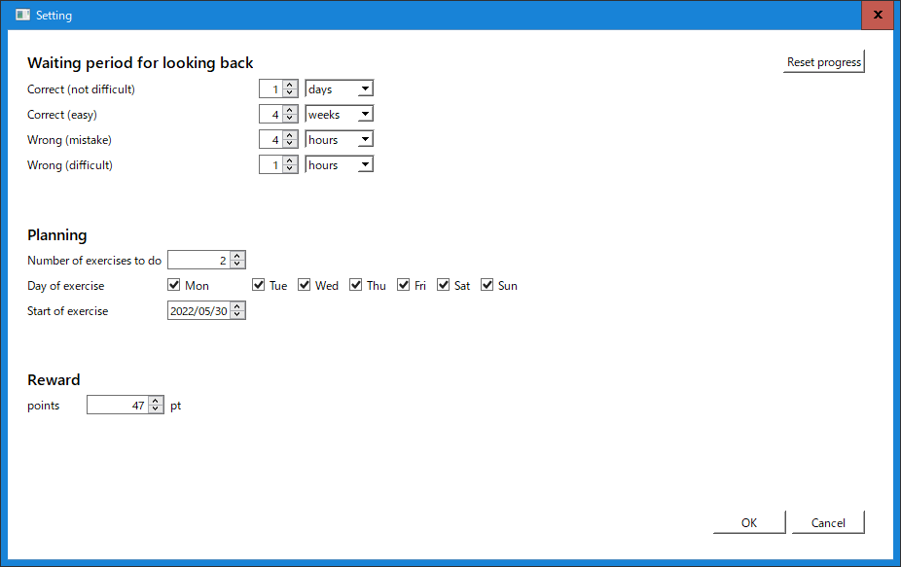
Setting
Waiting period for each button on the main screen.
The period set will be shown on the main screen and the question the user answered will be re-shown according to this period.
If this button is clicked, the progress information for the user will be deleted.
On the progress screen, the planned schedule line is drawn according to this setting.
Number of exercises to do per day.
Day of exercise (I have not implemented, so I would appreciate if you could implement)
Start of exercise: Start day of the planning.
Please add logout button if you could implement auto-login function on the login screen.
this is for future use.

Slide 10
Requirements
Supporting devices: mobile phone(iOS and Android) and PC
Languages: Multi-language including Japanese (UI and contents data)
Development:
Web application
Frontend: Vue (If possible, it would be prefered to use Typescript.)
Backend: Django/Python
Database: MySQL
If possible, it would be helpful to deliver with Dockerfile.
I leave the layout and design to you.(Your 2D&3D Art Design Demo is very cool) . Please make it cool!

